Slide 1
Flask_MySQL User Authentication App

Slide 2
Purpose of the App:
A simple Flask application for user authentication (sign-up, login, and logout).
Uses MySQL to store user data securely (passwords are hashed).

Slide 3
Tech Stack:
Backend: Flask
Database: MySQL
Security: bcrypt for password hashing
Web Development: HTML, Jinja2, CSS (for frontend)

Slide 4
Features of the App
User Registration:
Users can register with their name, email, and password.
Passwords are securely hashed before storing in the database.
User Login:
Users can log in using their email and password.
Password verification using bcrypt.
User Dashboard:
After login, users are redirected to a dashboard with their info.
User Logout:
Users can log out, which will clear their session data.

Slide 5
Flowchart or Architecture
homepage
Registers or Logs in
Dashboard
Logout

Slide 6
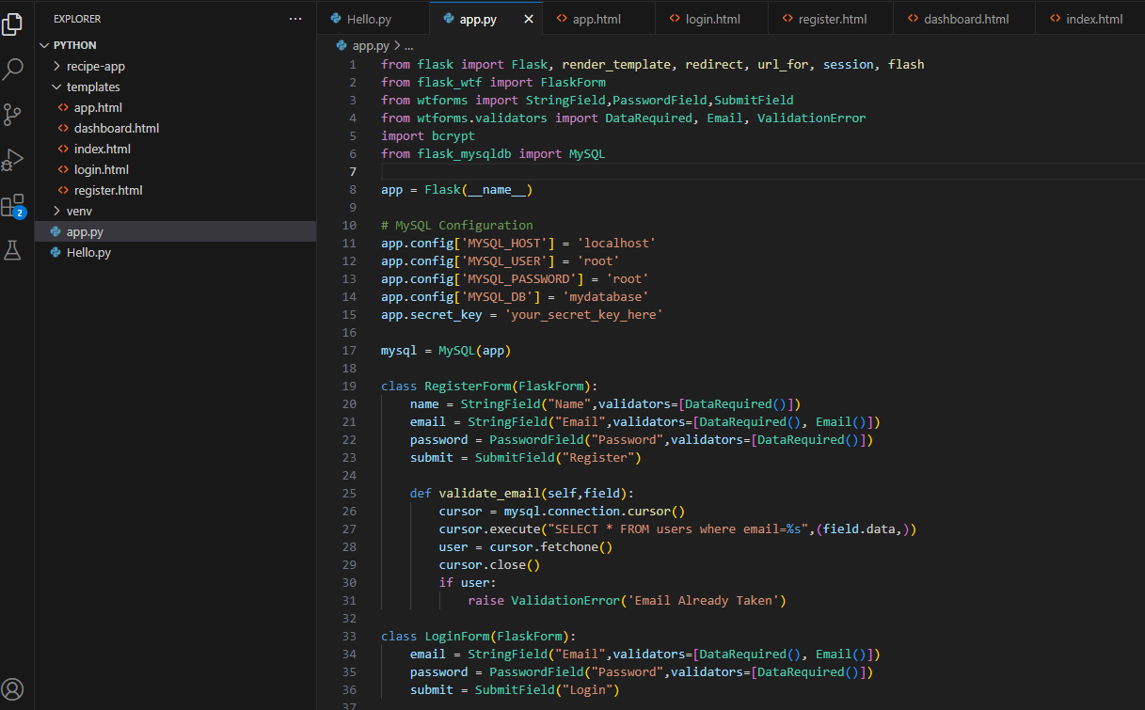
Code Structure

Slide 7
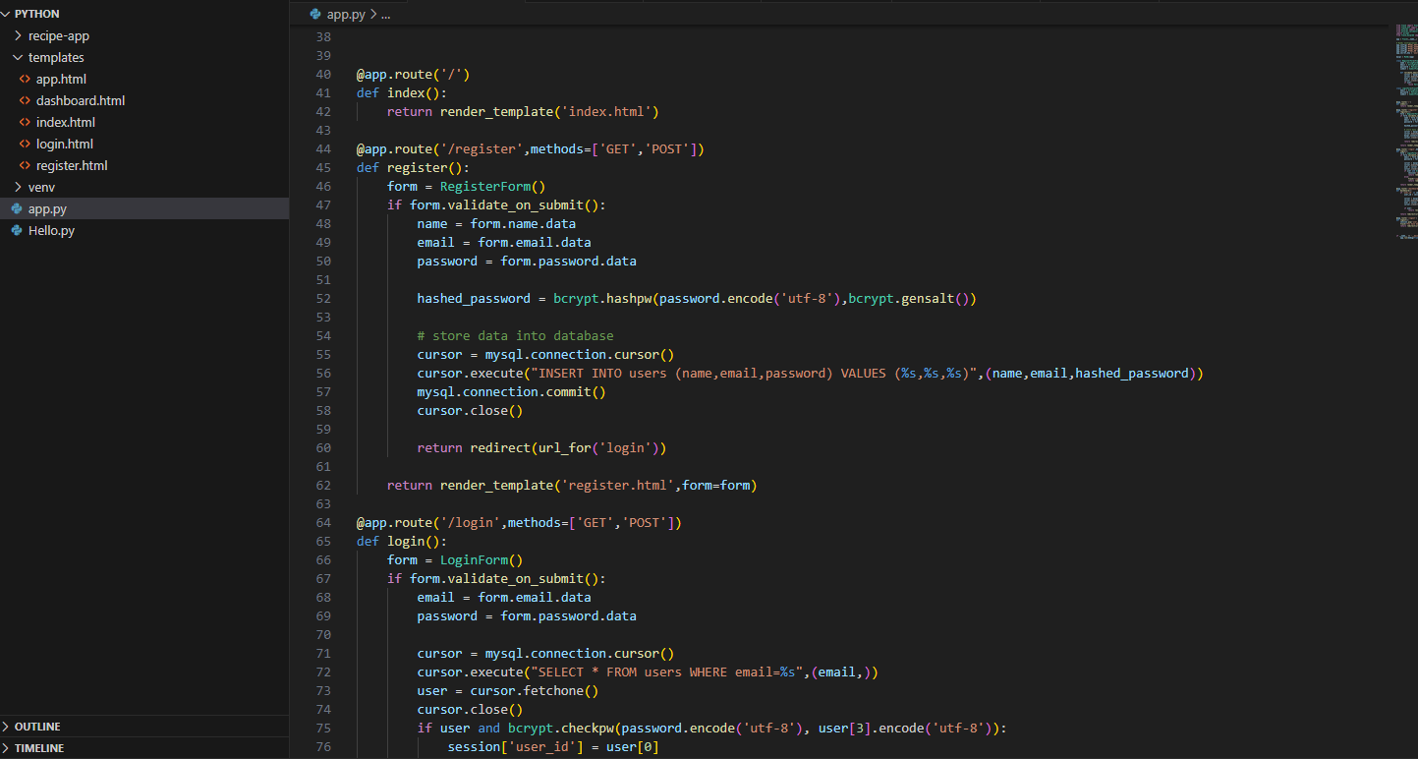

Slide 8
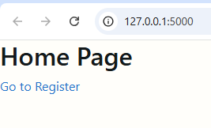
Frontend
Home Page

Slide 9
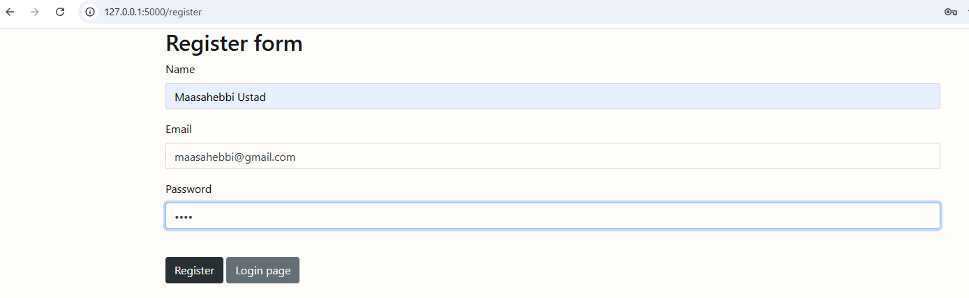
Register Page

Slide 10
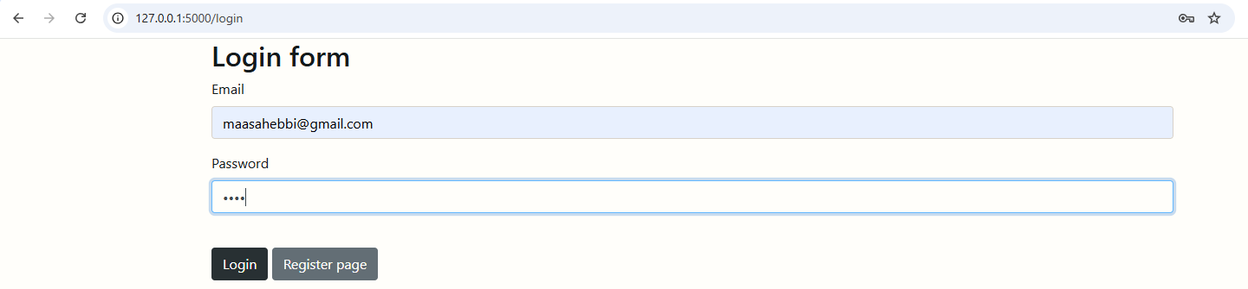
Login Page

Slide 11
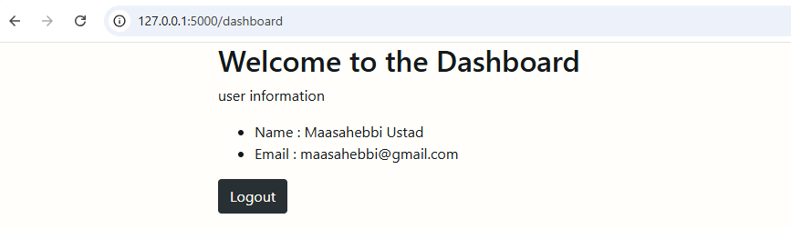
Dashboard Page

Slide 12
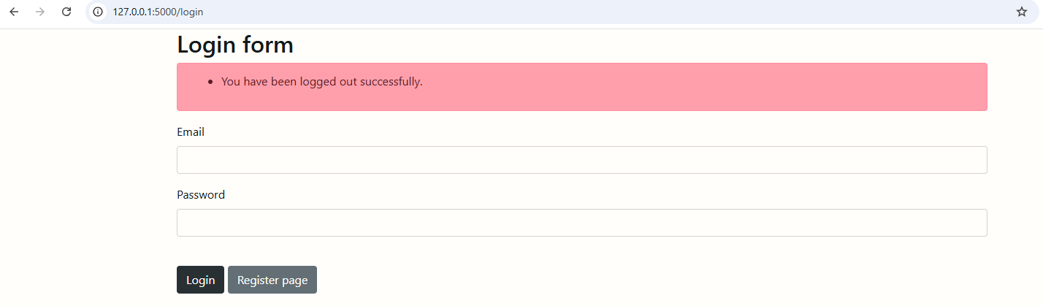

Slide 13
THANK YOU

